Slide 1


Investigating Vehicle Recall Trends and Characteristics
Course: Data Mining
Lecturer: Chen Hajaj
Team Members: Yogev Ladani, Amit Fallach
Github: https://github.com/YogevLD/Advanced-Machine-learning.git

Slide 2
Table of context
Introduction
Research Goals
Dataset and Features
Preprocessing
Methodology PCA
Methodology Kernel PCA
Methodology Hierarchical Trees
Results & Discussion
Conclusion and Future Work

Slide 3
Introduction
There is a growing interest in understanding the underlying factors contributing to vehicle recalls and their impact on vehicle usage patterns, maintenance requirements, and safety issues.
Vehicle recalls continue to occur regularly due to various factors such as manufacturing defects, design flaws, and safety regulation violations.

Slide 4


Research Goals
investigate the relationships between different characteristics of vehicles and circumstances related to their removal from service.
investigate anomalies or unusual events, to contributing to a deeper understanding of the underlying data patterns and potential real-world implications.

Slide 5
Dataset and Features
Crawling the Data - used a simple API call to read data from data.gov.il. the data is updated once every 24 hours according to the new vehicles that receive recall calls in Israel.
Features - The features in the data describe each type of vehicle.
Examples of features:
1. sug_rechev_cd: Numeric column representing a code associated with the vehicle's type.
2. moed_aliya_lakvish: Text column representing the date of vehicle's import.
3. mishkal_kolel: Numeric column representing the vehicle's weight.
4. ramat_eivzur_betihuty: Numeric column representing the vehicle's insured value.
5. shnat_yitzur: Numeric column representing the production year.

Slide 6
Preprocessing
Handling missing values
Reducing Redundancy: Eliminate one column from each pair exhibiting perfect correlation to streamline data analysis and model efficiency.
Categorical columns encoding
Scaling numeric columns

Slide 7
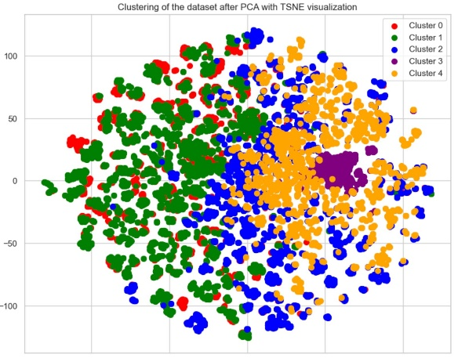
Methodology PCA
PCA for Dimensionality Reduction: Applied despite known limitations for linear and high-dimensional data.
Results: Created 50-52 principal components, explaining 90% of the variance without compromising clustering quality.
Clustering Analysis: K-means with K=5 retained data structure before and after PCA as confirmed by silhouette scores.
Parameter Selection: Chose K using the scaled inertia method, details to follow.
t-SNE Visualization: Revealed overlapping clusters, suggesting a need for alternative approaches.

Slide 8
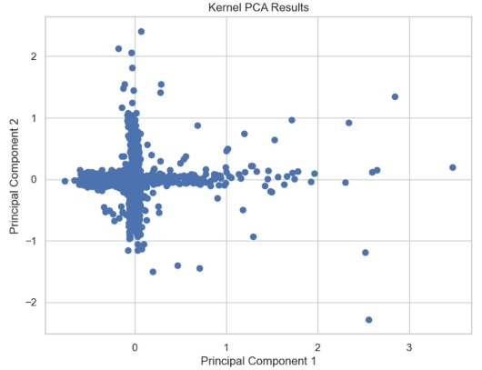
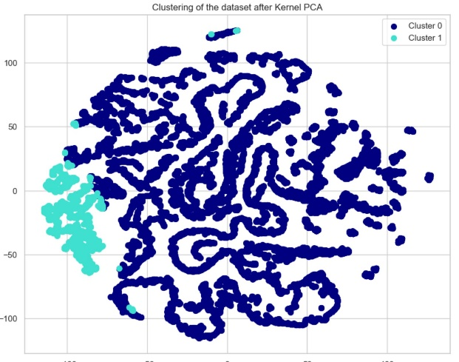
Methodology Kernel PCA
Kernel PCA Exploration: Sought non-linear relationships due to PCA's limitations.
Consistency Observed: Regular patterns in test outputs suggest stable key components.
In-depth Analysis: Combined Kernel PCA with K-means and visualized via t-SNE; no clear minimum found using scaled inertia.
Silhouette Assessment: Similar high silhouette scores (0.75-0.78) for cluster counts 2-6, indicating indistinct separations.
Visual Clarity: Chose K=2 after clear t-SNE visualization, revealing two distinct clusters of varying sizes.
Proceeding with Hypothesis: Adopted K=2 based on strong visual evidence, intending to validate with hierarchical trees.

Slide 9
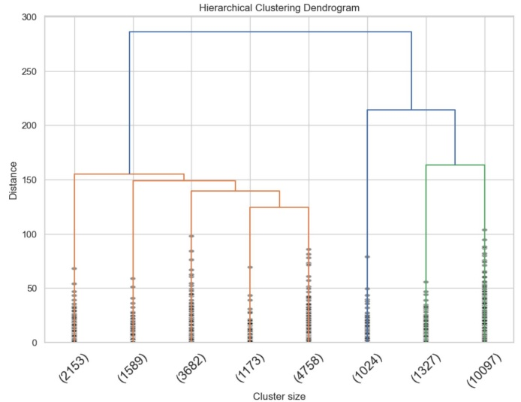
Methodology Hierarchical Trees
Hierarchical Tree Validation: Used to corroborate the two-cluster hypothesis.
Ward's Linkage Method: Chosen to minimize within-cluster variance without preconceptions.
Clear Cluster Division: Evident from the significant vertical distance in dendrogram.
Distinct Separation Noted: Subsequent divisions show less distinction, reinforcing the two-cluster model.
Uneven Division Acknowledged: Right side splits variably, reaffirming the choice for two clusters over three.

Slide 10
Results & Discussion
Results
Utilized Kernel PCA for non-linear dimensionality reduction; identified stable principal components.
Optimal K for clustering determined by scaled inertia; silhouette scores indicated K=2 as distinct.
Hierarchical clustering confirmed data division into two clusters with significant separation.
Discussion
Kernel PCA with sigmoid function selected over PCA for superior silhouette scores, capturing non-linearities.
Cluster analysis revealed:
Larger cluster: Medium-high vehicle weight, younger vehicle models.
Smaller cluster: Durable older models, lower weight, potentially indicating fewer malfunctions.
Implications for consumers and manufacturers on vehicle durability and production strategies.

Slide 11
Conclusion and Future Work
Conclusion:
- Research on vehicle life span delineated two distinct clusters.
Key Findings:
Larger cluster: diverse vehicle types.
Smaller cluster: older, more durable vehicles.
Potential Applications:
Data insights could inform a recommendation system for vehicle purchase based on longevity and budget.
Guidance for manufacturers on production strategies aligned with market demands and vehicle durability.
Future Work Slide:
Aim to enrich dataset for deeper insights into decommissioning causes.
Explore the development of predictive models for vehicle lifespan.
Consider expanding to a recommendation system for vehicle selection and manufacturing guidance.

Slide 12
Thank You !

